Slide 1
FACIAL EMOTION RECOGNITION SYSTEM
Team Mates:
M.Hanishkar (311517205006)
M.Sugantha Priyan (311517205050)
S.Prasanna (311517205030)
Internal guide : Mrs.M.R.Nithya
External guide :
Company Name :

Slide 2
OVERVIEW
Abstract
Introduction
Problem statement
Abstract
Literature survey
Drawbacks of the existing system
Proposed system
System architecture

Slide 3
OVERVIEW
Modules
Modules description
Software Requirements
Hardware Requirements
UML Diagrams
Implementation
Conclusion
Future Enhancements
References

Slide 4
PROBLEM STATEMENT
In our day to day life, emotions or facial expression are the prime factor which are required for communication purpose.
For humans it is quite easy to detect an emotion but difficult for a computer or a machine to do so.
As we are developing the need and importance of automatic emotion recognition, which supports Human Computer Interaction applications and can be modified as feedback system .

Slide 5
INTRODUCTION
The objective is to develop a system which can analyze the image and predict the expression of the person.
The project aims to integrate the concepts of Deep learning to recognize the facial emotions in humans.
Expressions can be derived from the live feed via system’s camera .

Slide 6
ABSTRACT
This project deals with the facial emotion recognition system.
It’s capable of detecting three emotions : Neutral, Happy and Sad.
In this work, user’s emotion using its facial expressions will be detected.
These expressions can be derived from the live feed via system’s camera.

Slide 7
LITERATURE SURVEY
TITLE | METHOD | ADVANTAGE
AMYGDALA-INSPIRED AFFECTIVE COMPUTING: TO REALIZE PERSONALIZED INTRACRANIAL EMOTIONS WITH ACCURATELY OBSERVED EXTERNAL EMOTIONS | This paper, proposes an amygdala-inspired affective computing framework to realize the recognition of all kinds of human personalized emotions. Similar to the amygdala, the instantaneous emergency emotion is first computed more quickly in a low-redundancy convolutional neural network compressed by pruning and weight sharing with hashing trick. | accuracy reached 85.72%.
AN ENHANCED HUMAN SPEECH EMOTION RECOGNITION USING HYBRID OF PRNN AND KNN | . In this research study, an enhanced human speech emotion recognition system using a hybrid of PRNN and KNN algorithms is designed. A cascaded system of Mel Frequency Cepstral Coefficient (MFCC) and Gray Level Co-occurrence Matrix (GLCM) was used for feature extraction process | better efficiency is observed.

Slide 8
TITLE | METHOD | ADVANTAGE
ROBUST REPRESENTATION AND RECOGNITION OF FACIAL EMOTIONS USING EXTREME SPARSE LEARNING | The proposed approach combines the discriminative power of extreme learning machine with the reconstruction property of sparse representation to enable accurate classification when presented with noisy signals and imperfect data recorded in natural settings. | The proposed framework is able to achieve the state-of-the-art recognition accuracy on both acted and spontaneous facial emotion databases.
LEVERAGING LARGE FACE RECOGNITION DATA FOR EMOTION CLASSIFICATION | propose an ensemble of several models, which capture spatial and audio features from videos. Spatial features are captured by convolutional neural networks, pretrained on large face recognition datasets. | It show that usage of strong industry-level face recognition networks increases the accuracy of emotion recognition.

Slide 9
DRAWBACKS OF EXISTING SYSTEM
Recognizing only static images
Perspective difference
Background interference
Less Accuracy

Slide 10
PROPOSED SYSTEM
The human faces are collected as a dataset through camera and converted to grayscale images, cropped and stored , which is further used for feature extraction using haarcasades .
After which with the help of datasets of each emotions, the system is trained using Convolutional Neural Network(CNN) algorithm.
Then the system prompts for camera access to get real-time facial expression and outputs the corresponding emotion and emoji in the window.

Slide 11
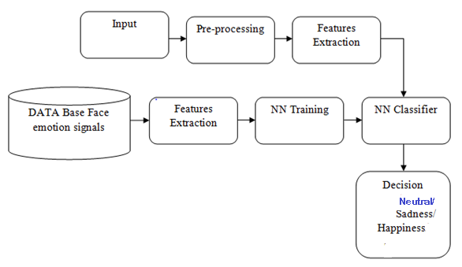
SYSTEM ARCHITECTURE

Slide 12
MODULES
The system here is divided into three modules as listed below:
      Creating dataset
      Learning using datasets
      Detection of emotion

Slide 13
MODULE DESCRIPTION
      CREATING DATASET : Unique folders are created for each emotion like Sad, Happy and Neutral. With the help of web camera the user adds the specific images in the corresponding folder based on the user inputs.
      LEARNING USING DATASETS : The learning of dataset is done using CNN with the help of libraries like tensorflow, keras,
      DETECTION OF EMOTION : The system prompts the user for web camera access and once the user allows it, the system capture the input of realtime facial expression and shows in the output window along with the correct predicted emotion.

Slide 14
SOFTWARE REQUIREMENTS
Requirements | Specification
IDE | PYCHARM
CODING LANGUAGE | Python
OPERATING SYSTEM | Windows

Slide 15
HARDWARE REQUIREMENTS:
S.No | REQUIREMENTS | RECOMENDED | MINIMUM REQUIREMENTS
1 | Operating System | Windows 10 | Windows 10
2 | RAM | 8 GB | 4 GB
3 | HDD | 1 TB | 1 TB
4 | Processor | Intel Core i7 | Intel Core i3

Slide 16
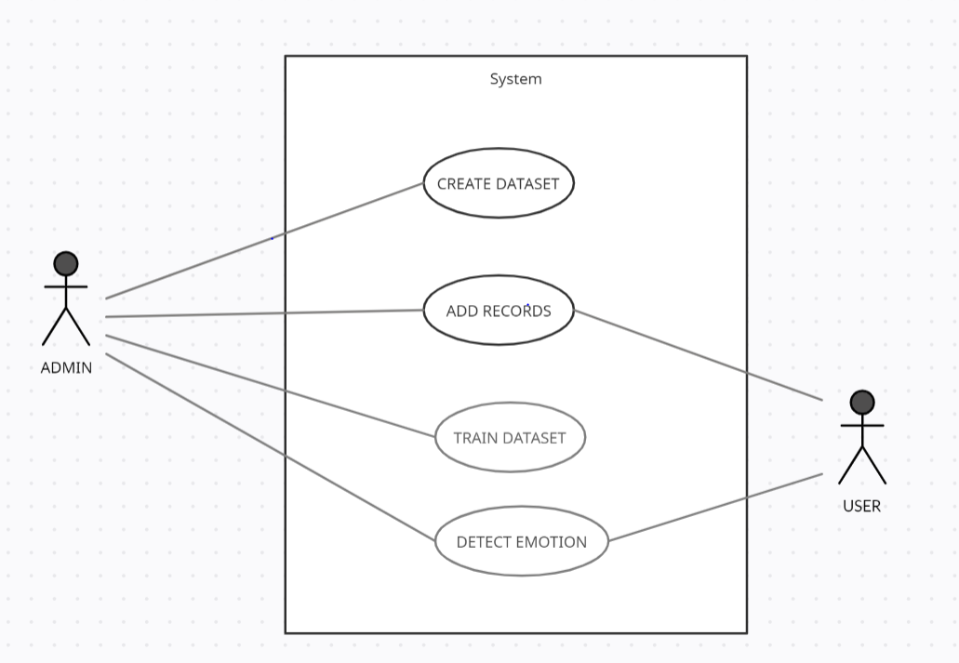
USECASE DIAGRAM

Slide 17
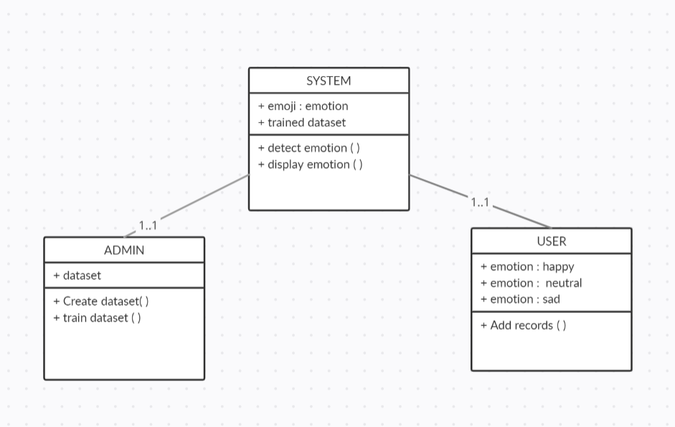
CLASS DIAGRAM

Slide 18
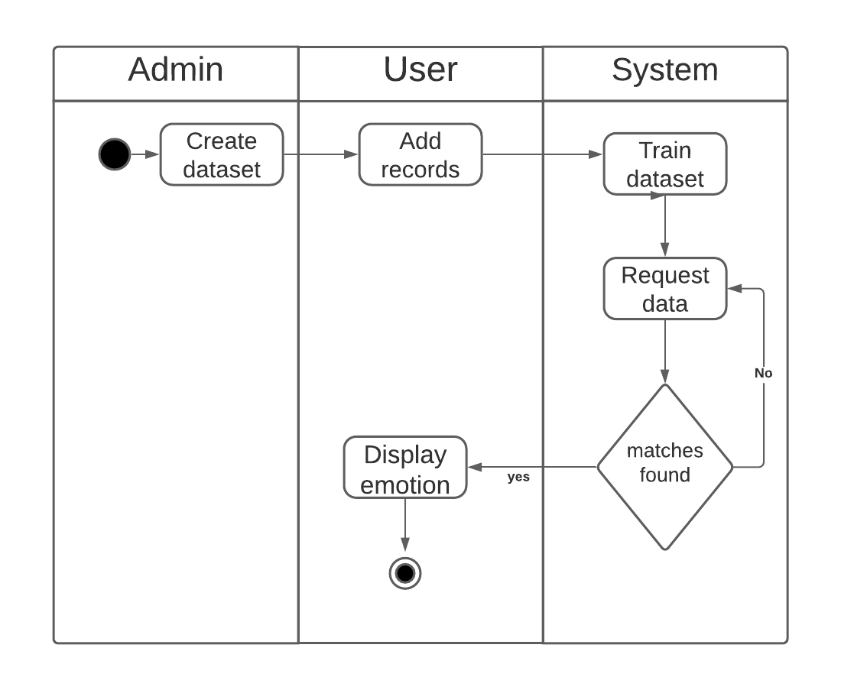
ACTIVITY DIAGRAM

Slide 19
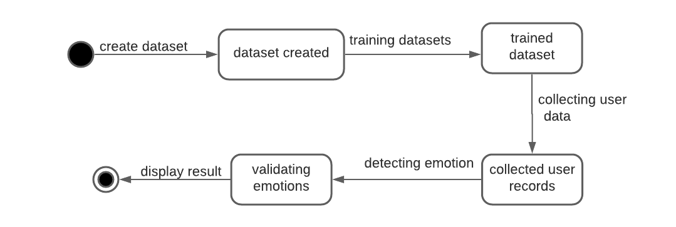
STATE CHART DIAGRAM

Slide 20
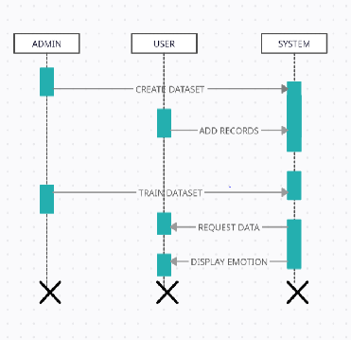
SEQUENCE DIAGRAM

Slide 21
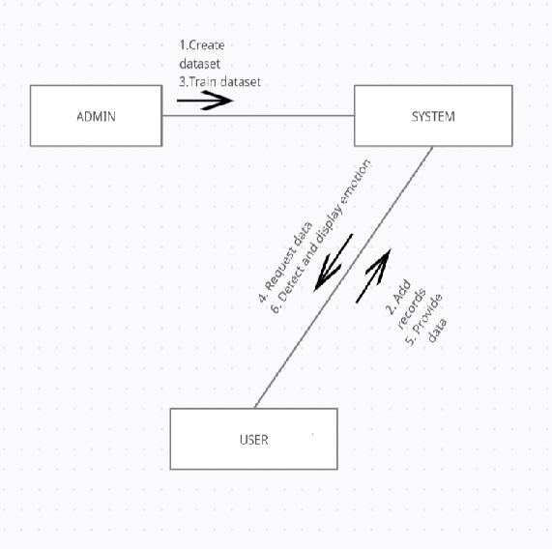

COLLABORATION DIAGRAM

Slide 22
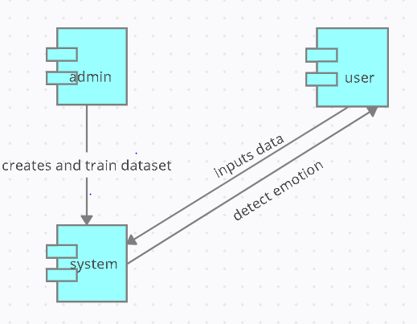
COMPONENT DIAGRAM

Slide 23
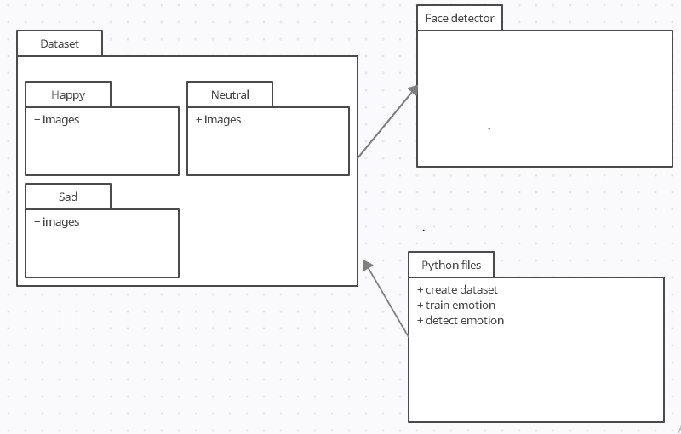
PACKAGE DIAGRAM

Slide 24
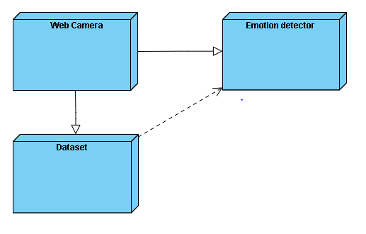
COMPONENT DIAGRAM

Slide 25
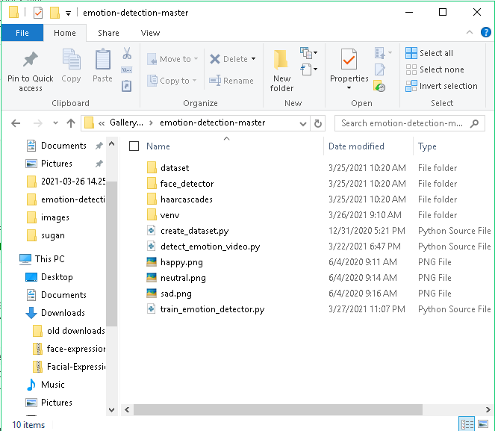
IMPLEMENTATION

Slide 26
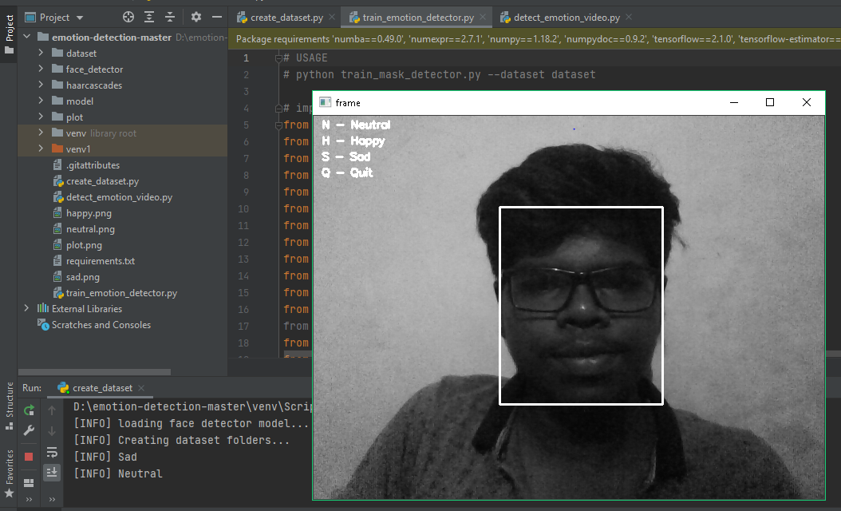
RESULT

Slide 27

RESULT

Slide 28
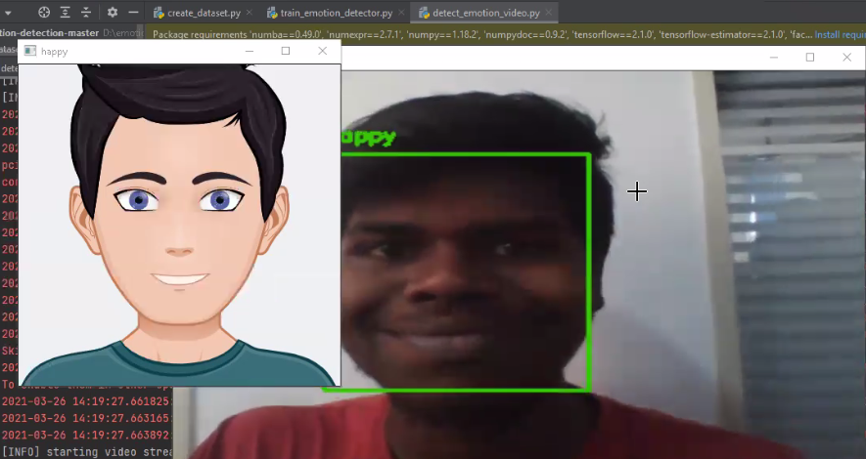
RESULT

Slide 29
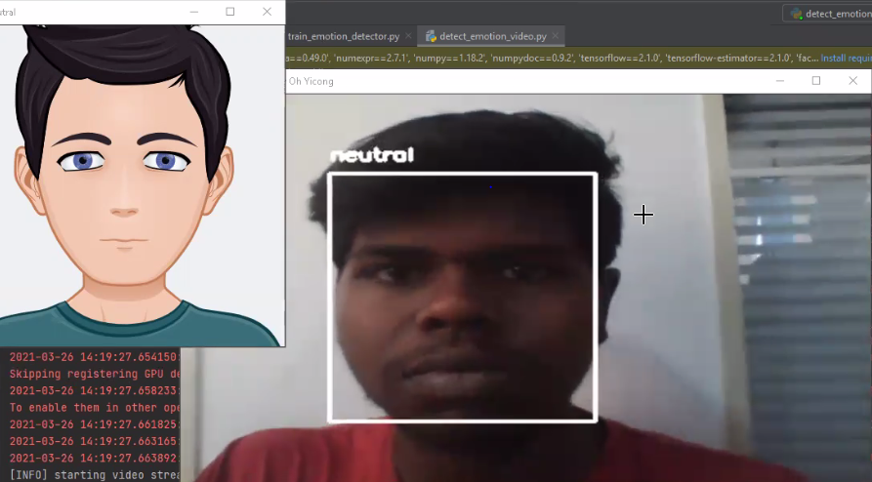
RESULT

Slide 30
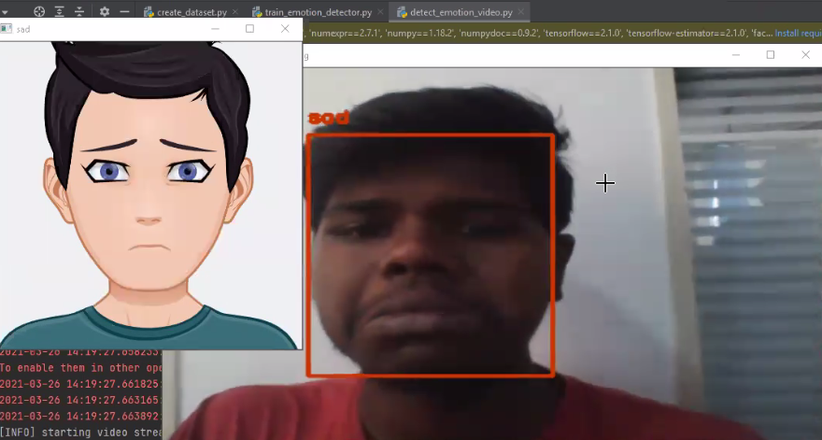
RESULT

Slide 31
CONCLUSION
A reliable, secure, fast and an efficient Face Emotion detection system has been developed replacing a manual and unreliable system.
The more the training data the more the accuracy. So, the importance should be given to select quality dataset and make the right partition to achieve more efficient system.
There is no need for specialized hardware for installing the system as it only uses a computer and a camera.

Slide 32
FUTURE ENHANCEMENTS
Many customers can’t express their exactly all the time because words either written or spoken are not that powerful as human expressions.Thus implenting suitable feedback system from detected emotion for different companies enables them to devise strategic and efficient plans .
anti- spoofing techniques like eye blink detection could be utilized to differentiate live from static images in the case where face detection is made from captured images from the classroom.

Slide 33
REFERENCES
[1] H. Jung, S. Lee, J. Yim, and S. Park, “Joint fine-tuning in deep neural networks for facial expression recognition,” in IEEE International Conference on Computer Vision, 2015.
[2] X. Zhao, X. Liang, L. Liu, T. Li, Y. Han, N. Vasconcelos, and S. Yan, “Peak-piloted deep network for facial expression recognition,” in European Conference on Computer Vision. Springer, 2016, pp. 425– 442.
[3] C. A. Corneanu, M. O. Sim´on, J. F. Cohn, and S. E. Guerrero, “Survey on rgb, 3d, thermal, and multimodal approaches for facial expression recognition: History, trends, and affect-related applications,” IEEE transactions on pattern analysis and machine intelligence, vol. 38, no. 8, 2016.
[4] A. Mohammadian, H. Aghaeinia, and F. Towhidkhah, “Incorporating prior knowledge from the new person into recognition of facial expression,” Signal, Image and Video Processing, vol. 10, no. 2, pp. 235–242, 2016.

Slide 34
REFERENCES
[5] S. Rifai, Y. Bengio, A. Courville, P. Vincent, and M. Mirza, “Disentangling factors of variation for facial expression recognition,” in European Conference on Computer Vision, 2012, pp. 808–822.
[6] P. Werner, A. Al-Hamadi, K. Limbrecht-Ecklundt, S. Walter, S. Gruss, and H. C. Traue, “Automatic pain assessment with facial activity descriptors,” IEEE Transactions on Affective Computing, vol. 8, no. 3, pp. 286–299, 2017.
[7] K. Dobs, J. Schultz, I. B¨ ulthoff, and J. L. Gardner, “Task-dependent enhancement of facial expression and identity representations in human cortex,” NeuroImage, vol. 172, 2018.

Slide 35
THANK YOU

